Slide 1
Working with Google Sheets using Python
Badrinadh Aila Sep-13-2021

Slide 2
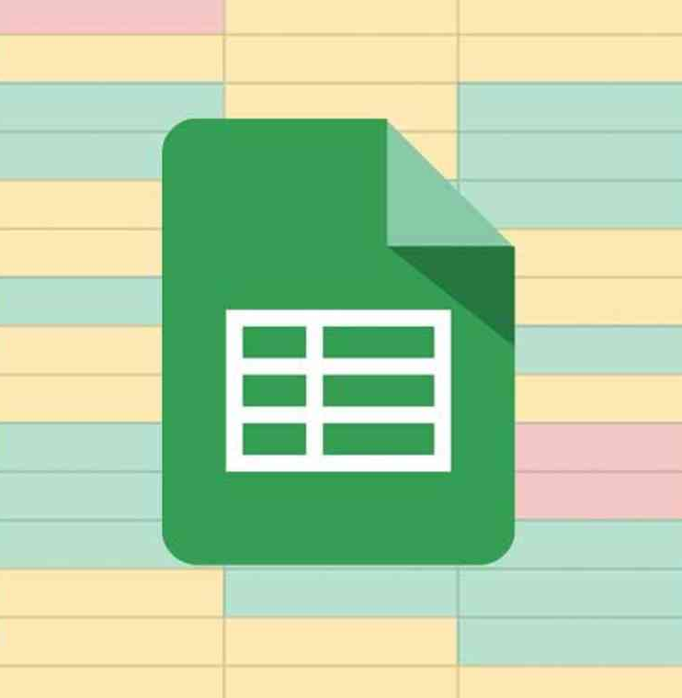
What is a Google Sheet?
Why should we learn about Google Sheets?
Why Python?

Slide 3
Setup
1. Install Python
Source: https://www.python.org/downloads/
2. Install a text editor (Visual Code Personal Recommendation)
Source: https://code.visualstudio.com/download
3. Install pip (It includes with in the Python file with version v3.0+)

Slide 4
WorkFlow
1. Install the Google client library
Pip3 install --upgrade google-api-python-client google-auth-httplib2 google-auth-oauthlib
2. Copy the example
https://developers.google.com/sheets/api/quickstart/python#step_1_install_the_google_client_library
3. Visit the Google Cloud Platform to create a project
https://console.cloud.google.com/apis/dashboard?project=data-gearbox-321123&folder=&organizationId=
4. Enable Google Sheets API

Slide 5
Workflow (Contd.)
5. Create a Service Account under Credentials
6. Share the file with the service account created
7. Create a Key to the service account created. Copy the .Json file to the project folder.
8. Add the Key and credentials in the python file
https://developers.google.com/identity/protocols/oauth2/service-account#python
9. Get the Spreadsheet ID
10. Grab the example for writing the file
https://developers.google.com/sheets/api/reference/rest/v4/spreadsheets.values/update

Slide 6
Resources
https://www.python.org/downloads/
https://code.visualstudio.com/download
https://developers.google.com/sheets/api/quickstart/python#step_1_install_the_google_client_library
https://console.cloud.google.com/apis/dashboard?project=data-gearbox-321123&folder=&organizationId=
https://developers.google.com/identity/protocols/oauth2/service-account#python
https://developers.google.com/sheets/api/reference/rest/v4/spreadsheets.values/update

